Slide 1
Java Collections Framework

Slide 2
WTF?
Collection – named group of multiple elements. Allows to store, retrieve, manipulate, and communicate aggregate data.
A Collections Framework is a unified architecture for representing and manipulating collections.

Slide 3
Java Collections
Java objects that holds a group of Objects
Number of objects in the group is dynamic
Collections provide means of objects manipulation
All collections are tested and tweaked!

Slide 4
Collections Framework
Includes:
Interfaces
Implementations
Algorithms
package java.util.*

Slide 5
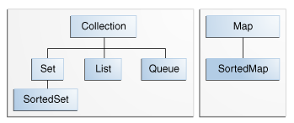
Java Collections

Slide 6
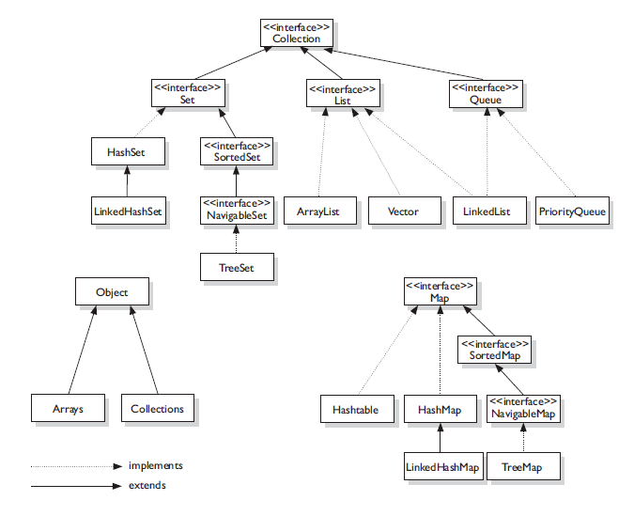
Java Collections

Slide 7
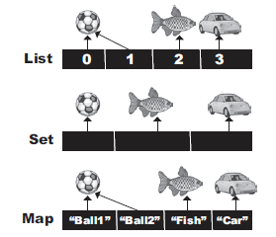
Java Collections
Collection – general group of elements
Set – unordered group, no duplicates
List – ordered group, duplicates are permitted
Map – group of key-value pairs
Queue – ordered/sorted group (FIFO), duplicates are permitted

Slide 8
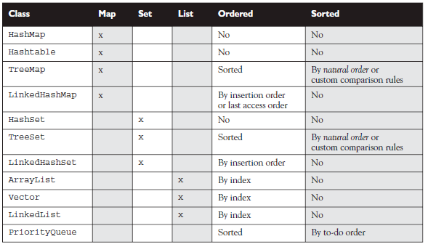
Sorted vs Ordered

Slide 9
Collections API
Collection is
the root interface
in the collections hierarchy
Collection
boolean add (Object)
boolean remove (Object)
boolean isEmpty ()
int size()
boolean contains (Object)
Iterator iterator()
Object[] toArray ()
Void clear()

Slide 10
Collections API: List
Represents ordered collection. Adds index-oriented methods:
add(int index, Object obj)
get(int index)
set(int index, Object obj)
indexOf(Object obj)
Two main implementations:
ArrayList
LinkedList
List
boolean add (int, Object)
boolean remove (int, Object)
boolean set (int, Object)
int indexOf (Object)

Slide 11
Collections API: List: using
List<String> list = new ArrayList<String>();
list.add(“hello”);
list.add(“world”);
list.add(1, “my”);
list.size() // == 3
// Note! This is not good way to iterate over List
for (int i=0; I < list.size(); i++) {
System.out.println(str.get(i));
}
list.remove(2);
{“hello”}, {“my”}, {“world”}
{“hello”}, {“my”}

Slide 12
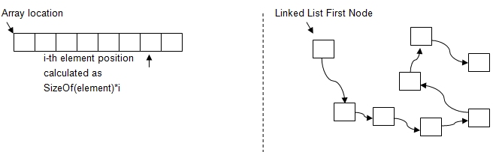
ArrayList vs LinkedList
Array List | LinkedList
get, set are O(1) | get, set are O(n)
add is O(1), O(n) in worst-case | add is O(1)
insert is O(n) | insert is O(n)
remove is O(n) | remove is O(n), Iterator.remove is O(1)
You will use ArrayList in 90%
Vector is similar to ArrayList but it is synchronized.
Stanford University online class

Slide 13
Quiz Is there any difference?
List<String> list1 = new ArrayList<String>();
List<String> list2 = new LinkedList<String>();
list1.add(“hello”);
list1.add(“world”);
list2.add(“hello”);
list2.add(“world”);
print(list1);
print(list2);

Slide 14
Hint
Take a look and understand the implementations of the Lists.

Slide 15
Array <-> List
Array to list:
List list = Arrays.asList(arr);
List to array:
Object[] arr = list.toArray();
Overloaded toArray() :
Object[] toArray();
<T> T[] toArray(T[] a);
Integer[] arr = new Integer[list.size()];
arr = list.toArray(arr);
- fills and returns specified array, if the list fits it.

Slide 16
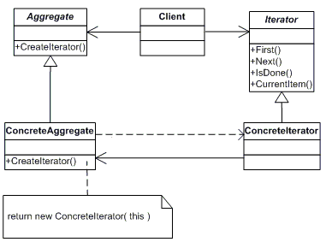
Iterator
An Iterator is an object that's associated with a specific collection. It lets you loop through the collection step by step and delete/modify specified elements if necessary.
Implementation the iterator design pattern.
Applicable to any collection
public interface Iterator<E> {
boolean hasNext();
E next();
void remove();
}

Slide 17
Using iterator
for (Iterator iterator = list.iterator(); iterator.hasNext();) {
String string = (String) iterator.next();
}
// or
Iterator<String> i = list.iterator();
while(i.hasNext()) {
String str = i.next();
}

Slide 18
Beware!
// BROKEN - throws NoSuchElementException!
for (Iterator i = list1.iterator(); i.hasNext(); ) {
for (Iterator j = list2.iterator(); j.hasNext(); ) { sum(i.next(), j.next()));
}
}

Slide 19
Using iterator
Note that Iterator.remove is the only safe way to modify a collection during iteration;
Iterator<String> it = list.iterator();
while(it.hasNext()) {
String element = it.next();
if (element.equals(”hello”)) {
it.remove();
}
}
/* this will throw an java.util.ConcurrentModificationException
*/
for(String str : list) {
if (str.equals(“hello”)) {
list.remove(str);
}
}

Slide 20
Iterable
public interface Iterable<T> {
/**
* Returns an iterator over a set of elements of type T.
*
* @return an Iterator.
*/
Iterator<T> iterator();
}
Interface Collection extends interface Iterable

Slide 21
Why Iterator
Can be faster as it knows internal representation of collection
Safe way to remove elements during iteration
Allow to work with collection without even knowing it’s type (Set, List, Tree, Hashtable)
For-each uses iterator behind

Slide 22
For-each loop
For-each is a simplified construction that is used to iterate over array of collection.
for (String string : list) {
print(string);
}

Slide 23
For-each
The same for arrays:
int[] arr = {1, 2, 3, 4, 5};
for (int i : a) {
result += i;
}

Slide 24
For-each
For-each for collections uses iterator behind:
for (String string : list) {
print(string);
}
is
for (Iterator<String> iterator = list.iterator(); iterator.hasNext();) {
print(iterator.next());
}

Slide 25
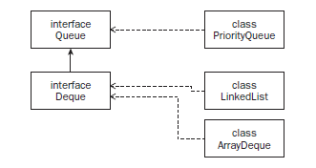
Queue
A queue is a collection whose elements are added and removed in a specific order: FIFO
Cant store null
Can have limited size

Slide 26
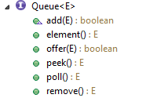
Queue methods
add – tries to add element, throws exception if cant
remove – removes head, throws exception if none
element - tries to get element, exception if none
offer – tries to add element, returns trues if succeeded
peek – get head element, null if none
pool – get and remove head element, null if none

Slide 27
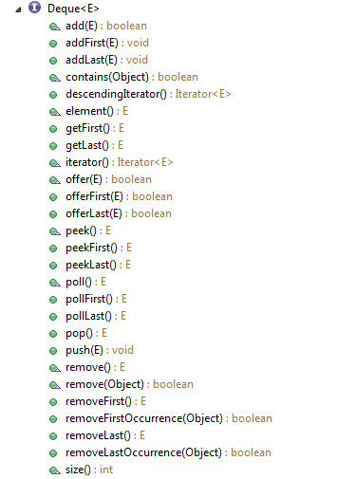
Deque
A deque (“ deck ”) is a double - ended queue that allows for elements to be inserted and removed at both ends of the queue.

Slide 28

Priority Queue
A queue where the elements are ordered based on an ordering you specify (as opposed to ordering based on FIFO).

Slide 29
summary
Collections used to store and manipulate data
Can hold only objects not primitives
Use iterator to iterate over all elements in List
Know particular implementations of collections

